Slide 1

HOTEL MANAGEMENT SYSTEM
Submitted by: Under the guidance of:
1. V. Vaishnavi Pooja Mehta
2. B. Pravalika
3. S.Tejashwini
4. J. Chandrika
5. P. Pallavi Srikala

Slide 2
INTRODUCTION
Hotel Management System is a web based application that allows the hotel manager to handle all hotel activities online.
It is to automate day by day activities of Hotels like room activities, registration of new customer and room allotment to the customers according to their demand and manage records
This application gives hotel manager the power and flexibility to manage the entire system from a single online system.
It provides room booking and other necessary hotel management features.
This system allows the manager to post available rooms in the system. Customers can view and book room online.

Slide 3
Project objective
The main objective of this project is to ensure reliable and efficient communication within hotel and avoid common input errors done by hotel staff.
This project provides solution for hotel management to manage most of their work using computerized process.
This software application will help admin to handle customers information, room allocation details, payment details.
Main important objective of Hotel management system project is to enforce security measures to avoid unauthorized access to the customer record.
This project also aims and fast and easy retrieval of hotel guest records for faster reference activities.

Slide 4
Hotel management benefits
Save time on admin tasks
Develop strong relationships with your guests
Manage distribution functions
Increase bookings
Accurate daily reports
Prevent double bookings and manual errors
High data security
Enhanced guest experience

Slide 5
TECHNOLOGIES USED
Java 1.8
Spring Boot 0.0.1+
Spring Framework 2.7.0+
Maven 4.0
Spring Data JPA(Hibernate)
MySQL
Postman
Validation

Slide 6
REQUIRED SPECIFICATION
Hardware Configuration | Software Configuration
System : 64-bit Operating System | Software IDE: Spring tool suite
RAM : 4GB Hard Disk:1TB | Language : Java
Operating System : Windows 10 | Back End : MySQL Server, Postman

Slide 7
PROPOSED SYSTEM
Hotel Management System is a project to maintain the record of hotel management system activities so this system is used to computerize all these activities.
With the help of this project we reduced task deployed for data/information collection to a large extent thereby eliminating the human errors considerably.

Slide 8
SPRING ANNOTATIONS
@Entity : This annotation specifies that the class is an entity and is mapped to a database table.
@Table : The @Table annotation specifies the name of the database table to be used for mapping.
@Id : The @Id annotation specifies the primary key of an entity.
@Column : @Column annotation is used for adding the column the name in the table of a particular MySQL database.
@Autowired : The annotation @Autowired in spring boot is used to auto-wire a bean into another bean.
@Service : It is used to mark the class as a service provider. @Service annotation is used with classes that provide some business functionalities.

Slide 9
@Repository : This annotation is used to indicate that the class provides the mechanism for storage, retrieval, update, delete and search operation on objects.
@RestController : The @RestController is used at the class level and allows the class to handle the requests made by the client.
@RequestMapping : It is used to map the web requests. It has many optional elements like consumes, header, method, name, params, path, produces, and value. We use it with the class as well as the method.
@GetMapping : It is used to retrieve/fetch the data.
@PostMapping : It is used to create new resource.
@PutMapping : It is used to update/replace the data.
@DeleteMapping : It is used to delete the existing data.

Slide 10
@RequestBody : This annotation indicates that Spring should deserialize a request body into an object.
@PathVariable : @PathVariable is a Spring annotation which indicates that a method parameter should be bound to a URI template variable.

Slide 11
USE CASE DIAGRAM
A use case diagram is a way to summarize details of a system and the users within that system.
Use case diagrams are typically developed in the early stage of development, the use case diagram consists of ADMIN and CUSTOMER and shows the interactions with a system.
The Admin and Customers in use-case diagrams describe what the system does and how the Customers use it, but not how the system operates internally.
Use case diagrams are used to gather the requirements of a system including internal and external influences. These requirements are mostly design requirements.

Slide 12
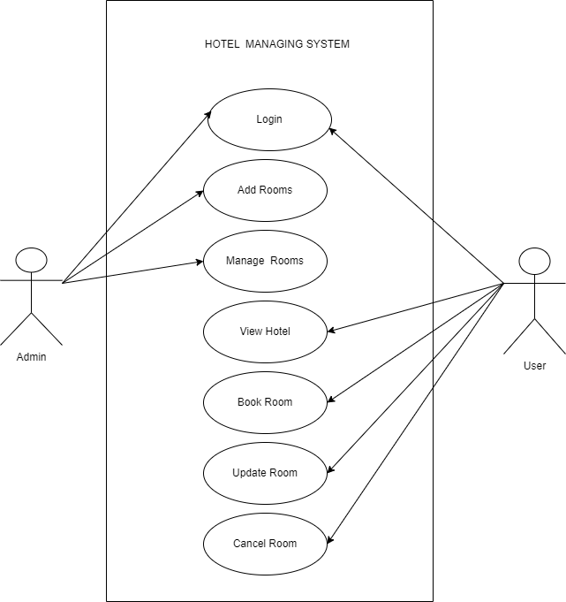

Slide 13
CLASS DIAGRAM
Class diagram is basically a graphical representation of the static view of the system and represents different aspects of the application. A collection of class diagrams represent the whole system.
Class diagram describes the attributes and operations of a class and also the constraints imposed on the system.
The class diagrams are widely used in the modeling of object-oriented systems because they are the only UML diagrams, which can be mapped directly with object-oriented languages.

Slide 14
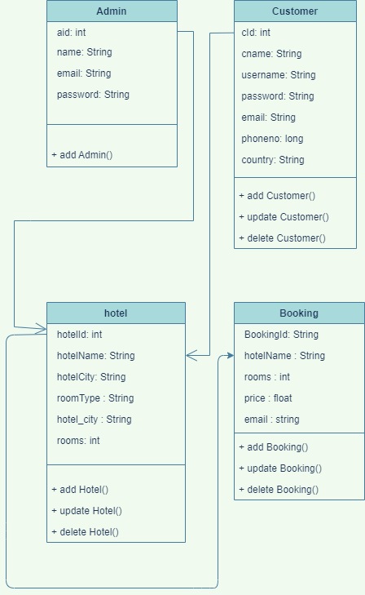

Slide 15
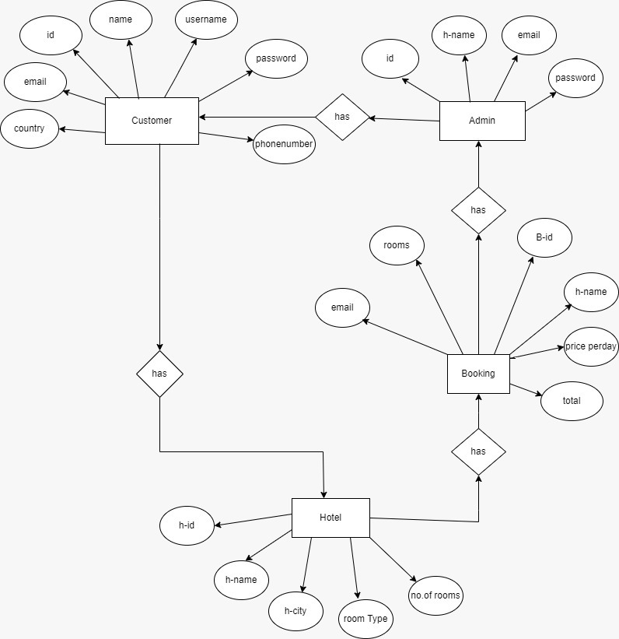
ER DIAGRAM

Slide 16
Resource Admin Booking Customer Hotel
POST Create Create a new Admin Create a new Booking Create a new Customer Create a new Hotel
GET Read Get All Admin details Get All Booking details Get All Customer details Get All Hotel details
PUT Update Update Admin details Update Booking details Update Customer details Update Hotel details
DELETE Delete Delete Admin Details Delete Booking Details Delete Customer Details Delete Hotel Details

Slide 17
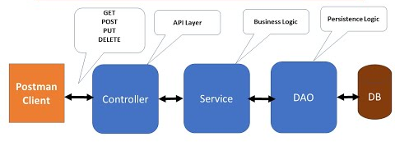
SPRING BOOT PROJECT ARCHITECTURE

Slide 18
ABOUT BACKEND
1. Service:
Spring boot service component is defined as a class file that includes the @Service annotation and allows developers to add business functionalities. The annotation used with the classes that provide these business functionalities.
2. Repository:
Spring is a popular java application framework and Spring Boot is an evolution of Spring that helps to create standalone, production grade Spring based applications easily. @Repository is a Spring annotation that indicated that the decorated class is a repository

Slide 19
3. POJO Classes:
The POJO class is an object that the encapsulates the Business logic. In an MVC architecture, the controller interacts with the business logic, which contacts with POJO class to access the data. It is the working of the POJO class. How to use POJO class in a java program. The POJO class is created to use the objects in other java programs.
4.Controller Classes:
In Spring Boot, the controller class is responsible for processing incoming REST API requests, preparing a model, and classes in Spring are annotated either by the @Controller or the @Rest Controller annotation.

Slide 20
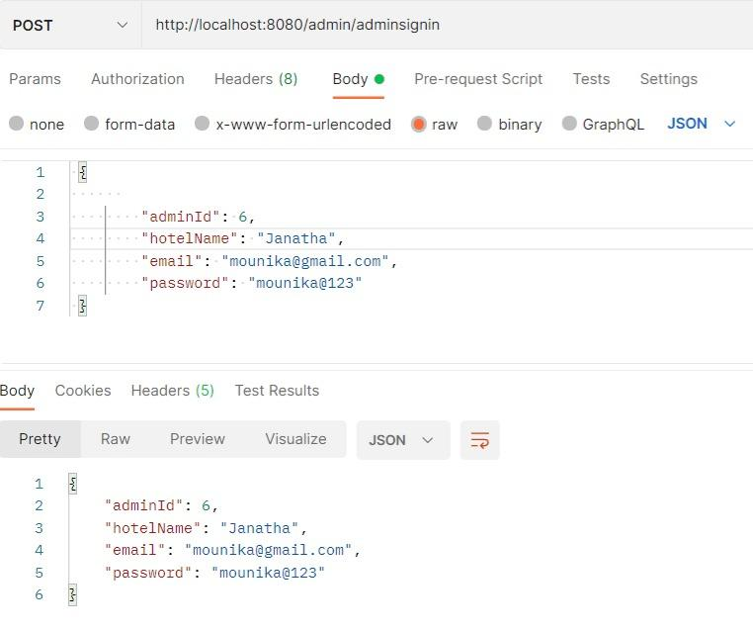
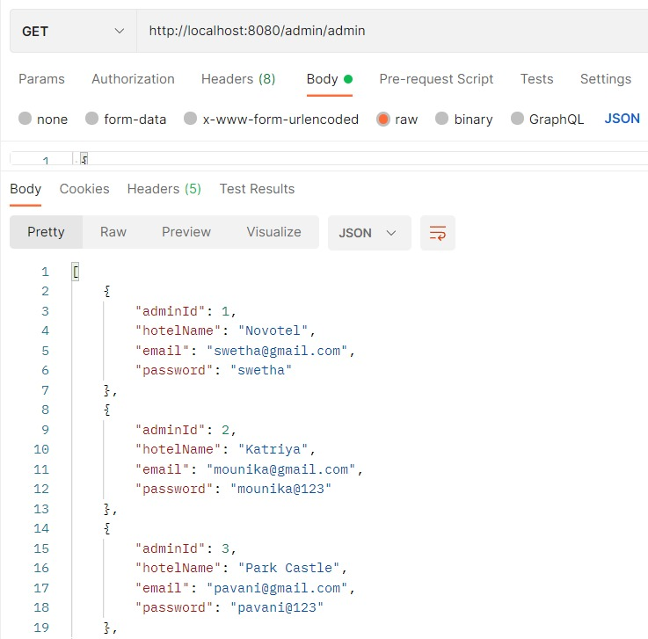
OUTPUT SCREENSHOTS admin/signin admin/display

Slide 21
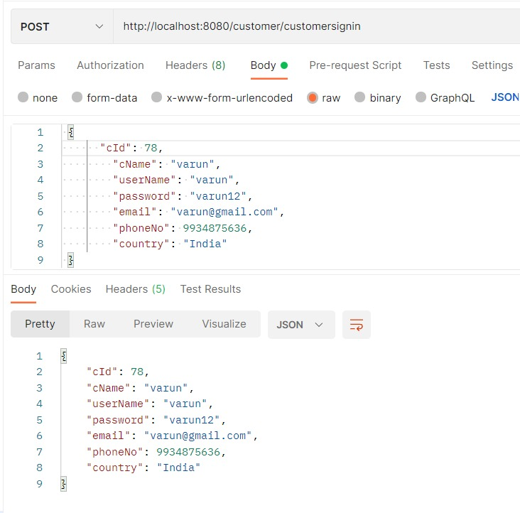
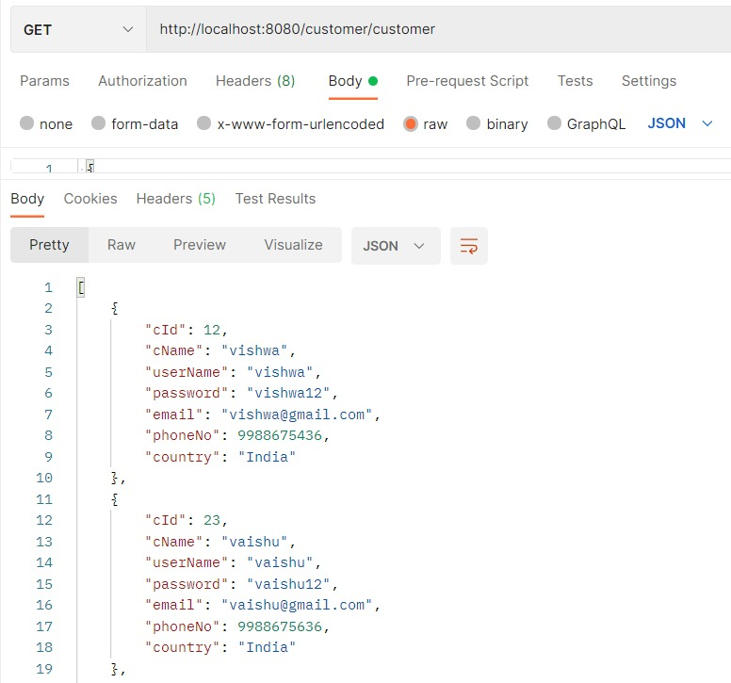
Customer/signin customer/display

Slide 22
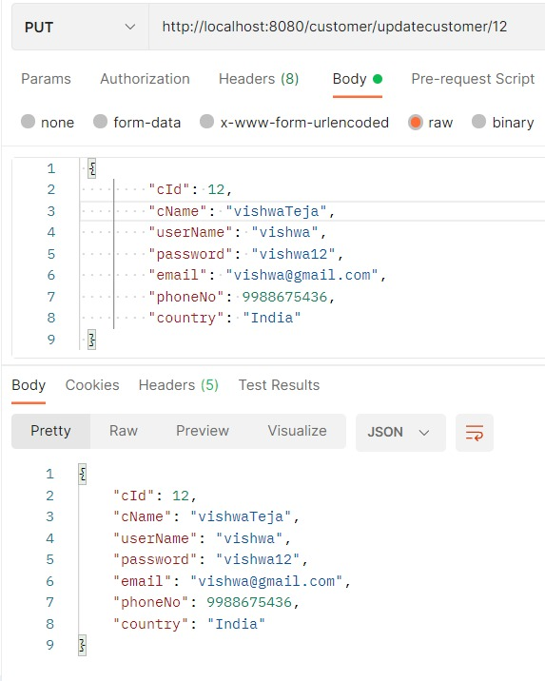
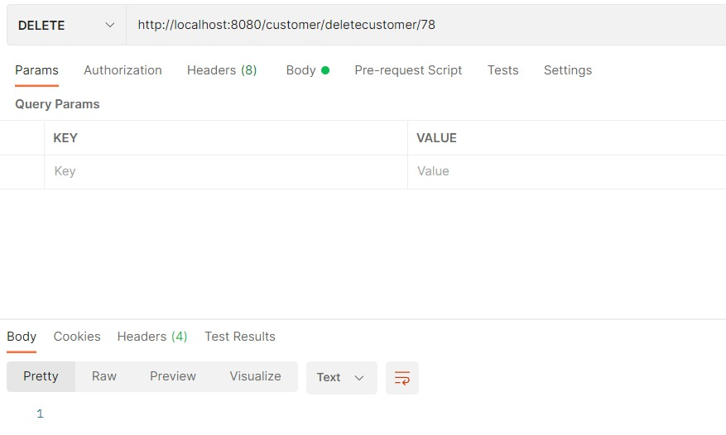
customer/update customer/delete

Slide 23
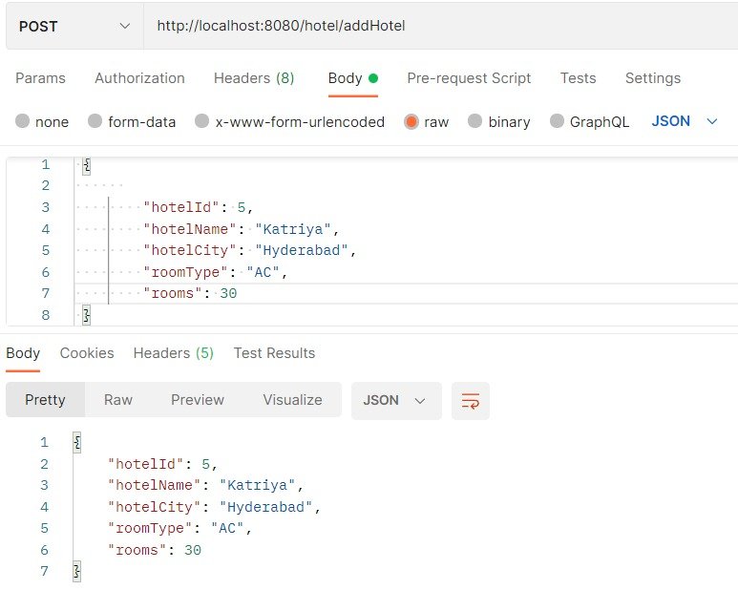
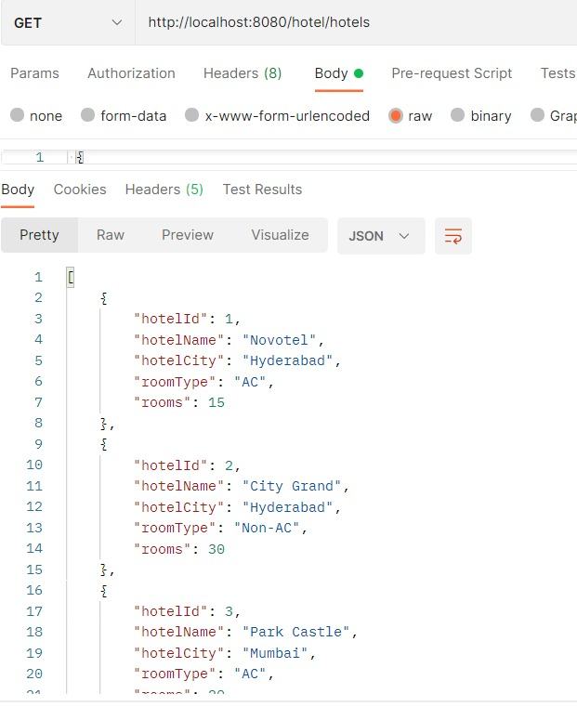
hotel/add hotel/display

Slide 24
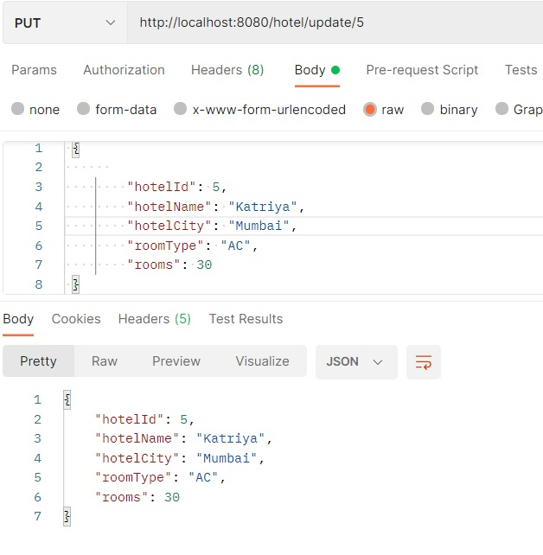
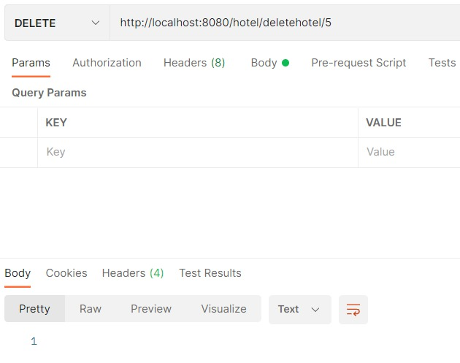
hotel/update hotel/delete

Slide 25
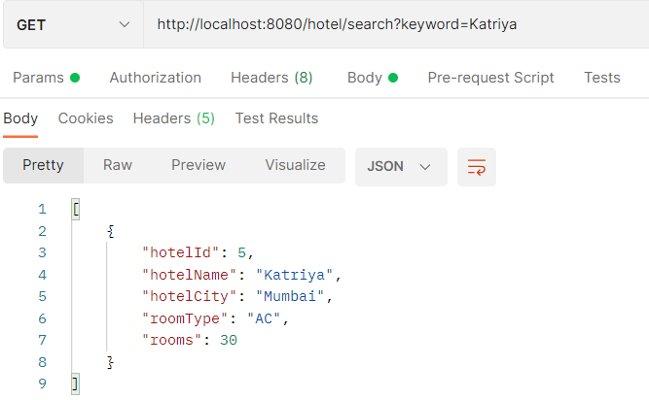
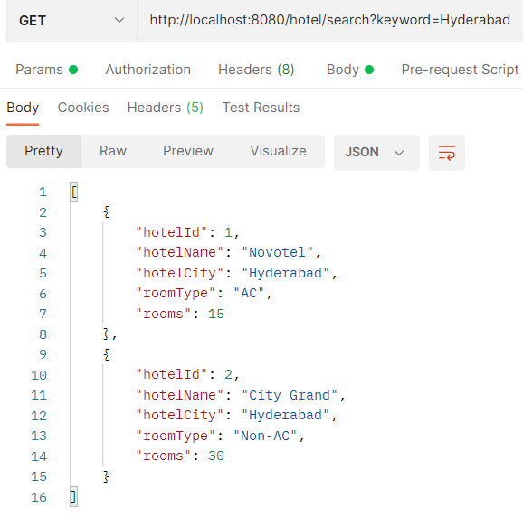
search/hotelname search/hotelcity

Slide 26
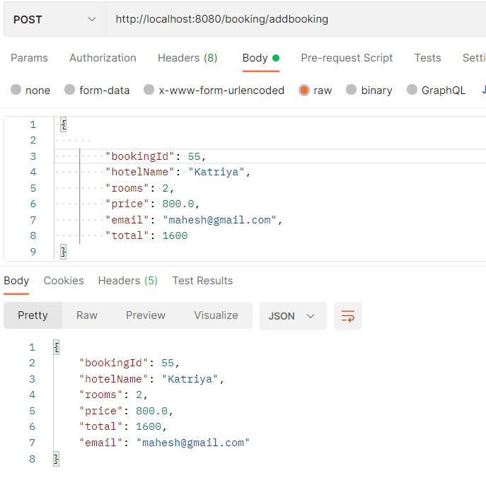
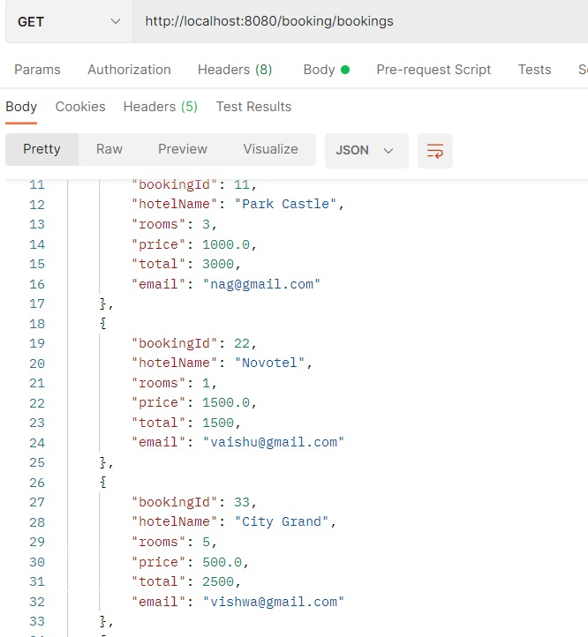
booking/add booking/display

Slide 27
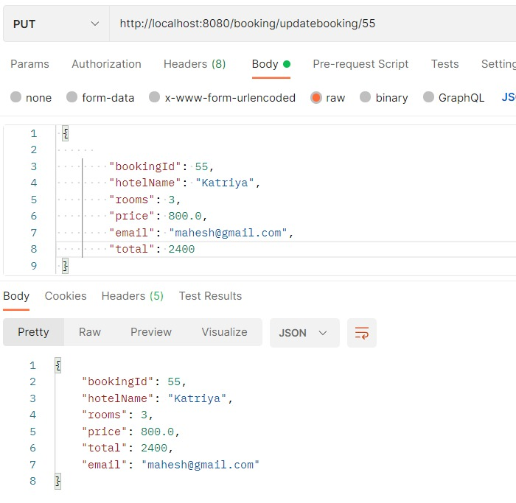
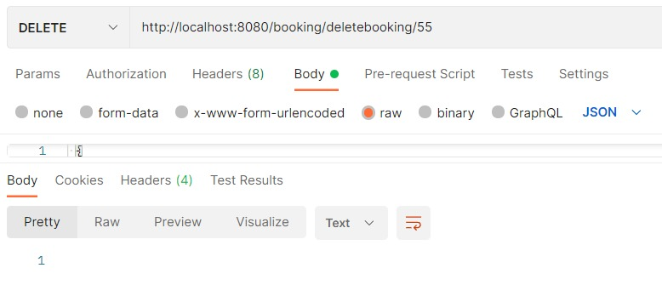
booking/update booking/delete

Slide 28
CONCLUSION
In this Hotel Management System, we have developed a secure, user-friendly Hotel Management System. This System can take care of each Customer. This System will Help the hotel staff to properly Manage their hotel and help in growth without creating any hassle.
This system is completely secure since every Customer is provided with a Customer ID and Password so there is no chance of any unauthorized access.
Online Booking of rooms make it easier to use. So, using this system will help in reducing the labor and provide more facility for Customer to like Hotel and visit again and again.

Slide 29
THANK YOU

